Slide 1
Sustainable optimization of LLMs using Bayesian surrogate-based pruning
Notes:
This project focuses on reducing the environmental impact of large language models by making pruning optimization more efficient using Bayesian surrogate models.

Slide 2
Context and Research question
Context
LLMs → high inference cost and environmental impact
Pruning reduces cost but requires many expensive experiments
Developers lack transparent tools for trade-offs
Approach
Bayesian surrogate model predicts pruning outcomes
Bayesian optimization reduces number of evaluations
Integrated into sustainability dashboard
Main Research Question
To what extent can Bayesian surrogate-based optimization guide magnitude-based pruning to reduce ecological impact while preserving performance and supporting transparent decision-making?

Slide 3
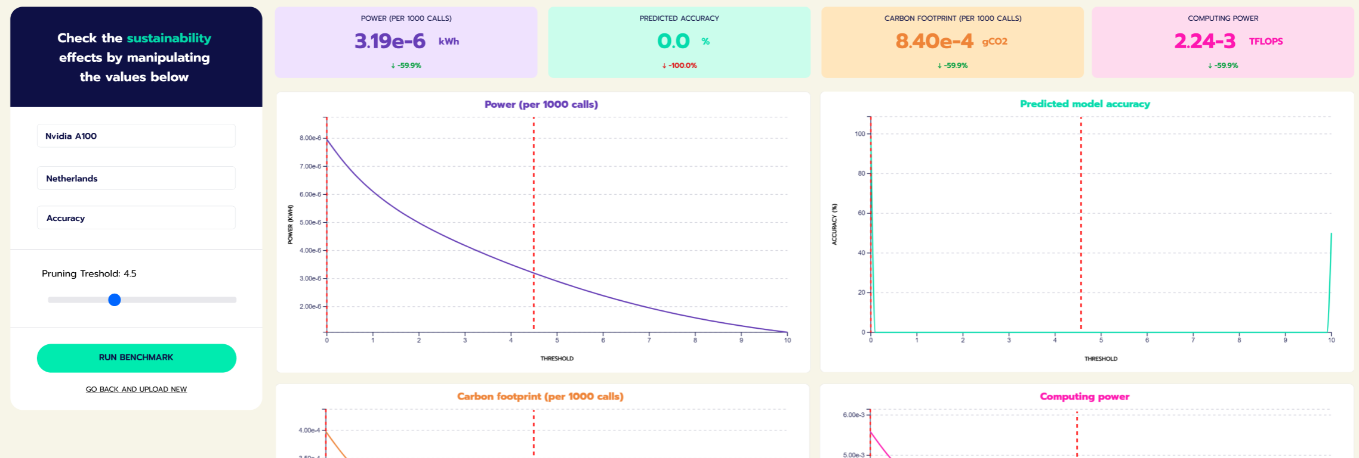
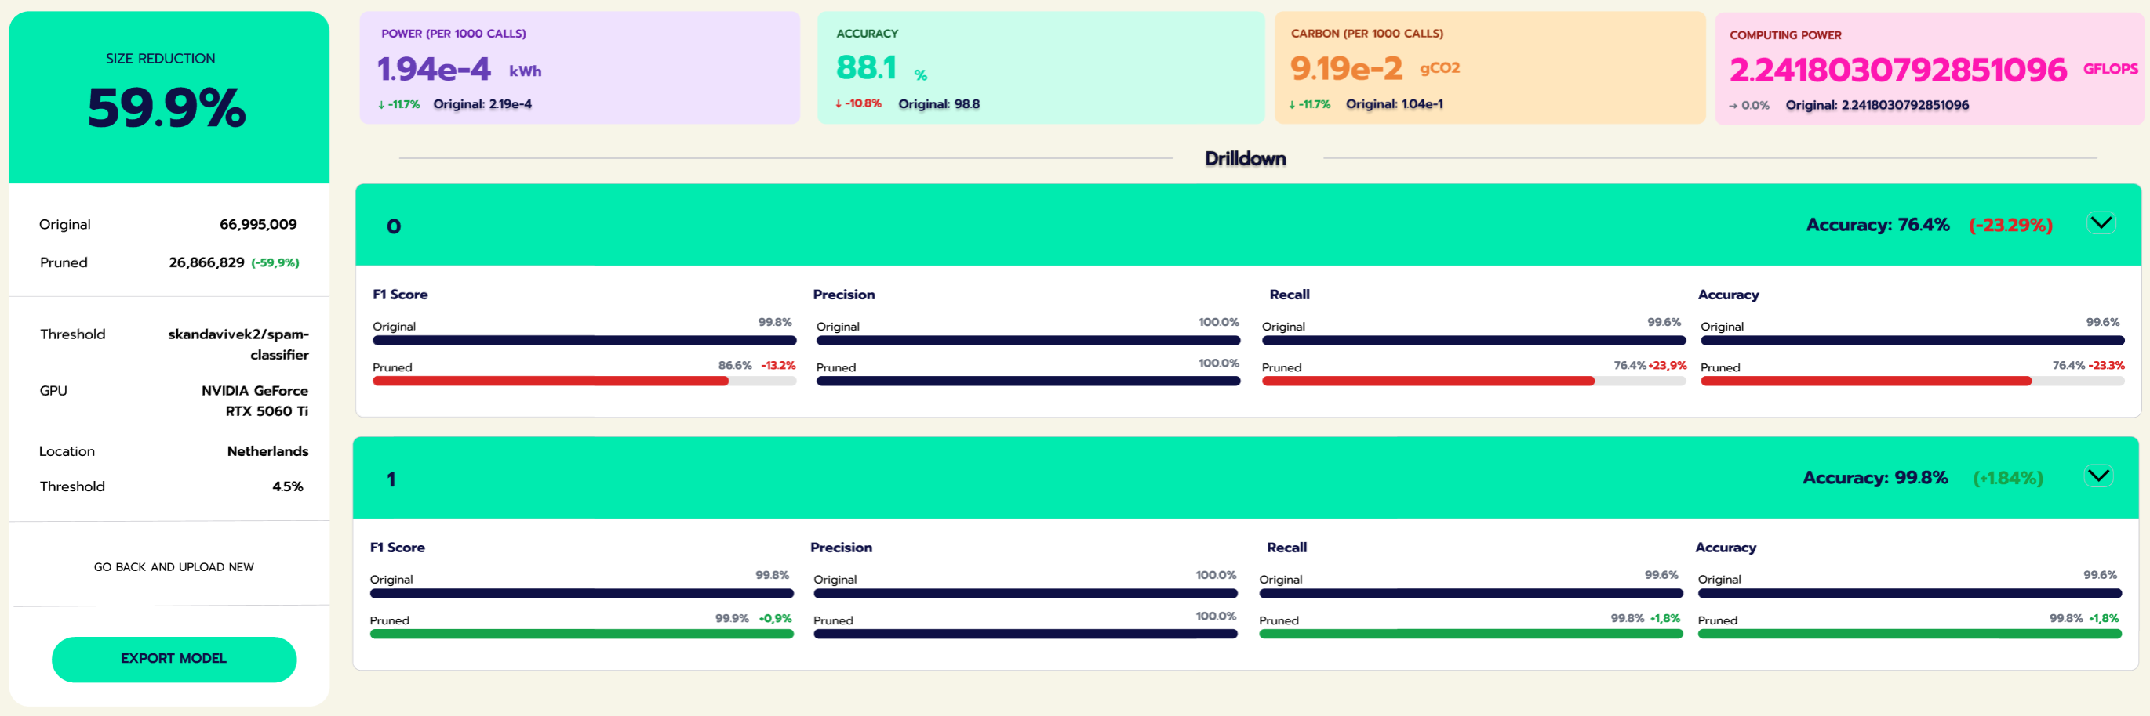

Slide 5
Dataset choice (WikiText-2)
Pros
Preserves natural language features (casing, punctuation, document structure), unlike older benchmarks like Penn Treebank
General-purpose benchmark for perplexity, not task-specific, so it measures overall language modeling quality before and after pruning
Small enough for rapid, repeated experimentation on limited hardware, but still has realistic vocabulary complexity 33k+ unique words
Widely adopted, enabling comparison with prior work
Cons / Limitations
Wikipedia domain bias: doesn't represent all real-world text
Benchmark saturation: models have been implicitly optimized for it over time
Perplexity improvements can reflect architecture tricks (memory, context length), not true understanding
Risk of data leakage: overlap with model training data
<unk> tokens from vocabulary cutoff can make perplexity artificially easier
Notes:
Colossal Clean Crawled Corpus (C4)

Slide 6
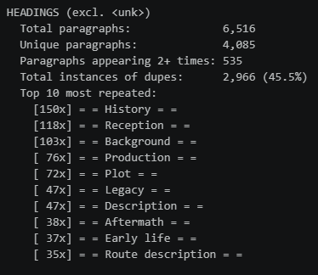
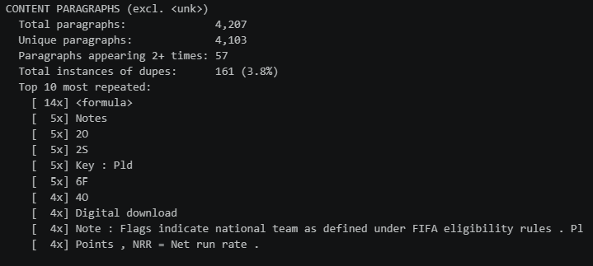
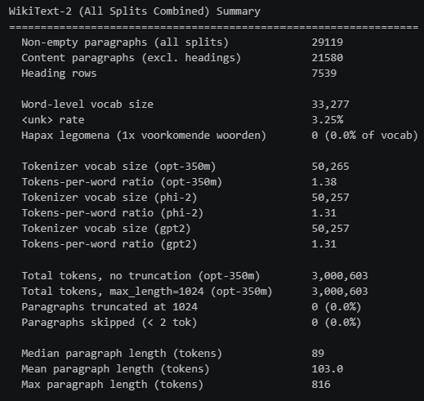
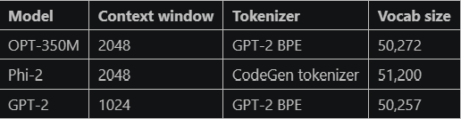

Slide 7
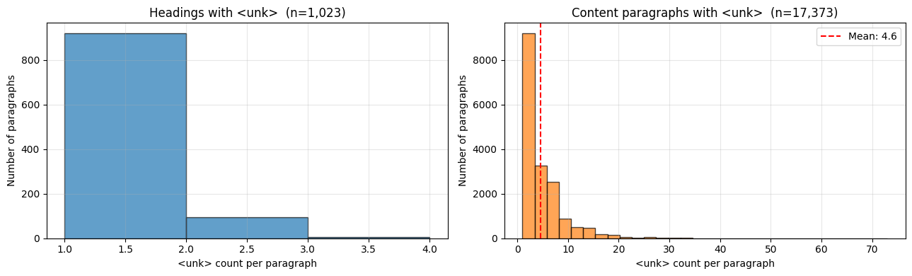
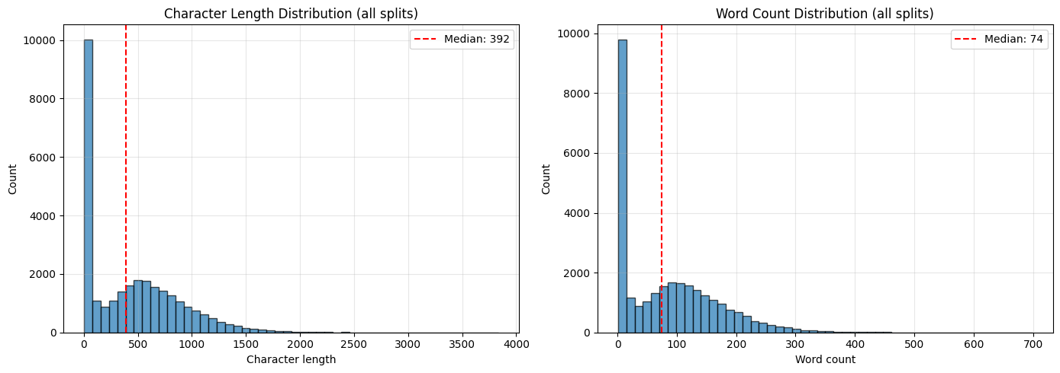

Slide 8
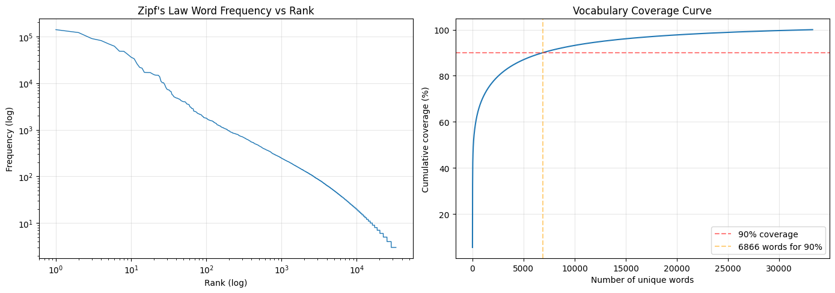

Slide 9
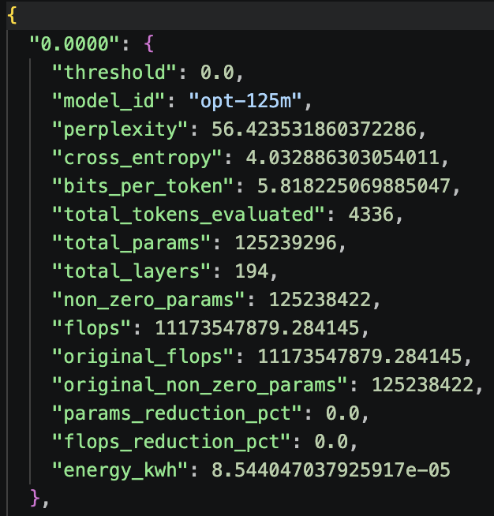
Step 1: Dataset creation with Active Learning with a Gaussian Process
Use a GP surrogate to model perplexity as a function of pruning threshold
At each step, evaluate where the GP is most uncertain (Max Variance acquisition) pure exploration, not optimization
Budget: 6 initial uniform samples + 25 iterations = 31 evaluations (~30% of grid search)
Also run the full grid search as a reference for comparison C
Check if the full 101 data points are needed, and worth the energy consumption
Evaluation time:
1 minute per prune & benchmark * 101 evaluations * 3 models = 5 hours to create the dataset

Slide 10
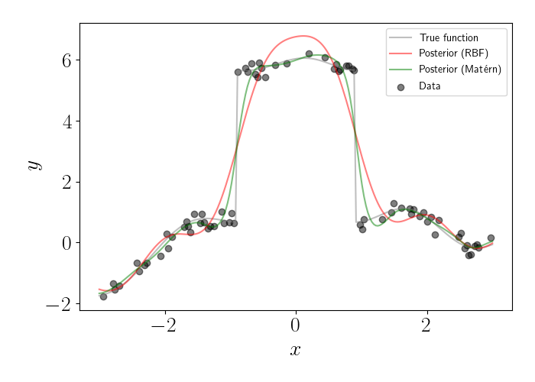
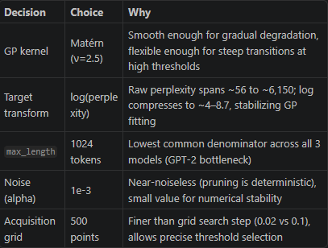
Gaussian Process setup
Why GP
Predicts both mean and uncertainty
Works well with small, sequential datasets
Enables uncertainty-based sampling (Max Variance)
Used for data acquisition, not final surrogate
Kernel Choice
Constant × Matérn (ν = 2.5)
Captures mostly smooth behaviour with possible sharp transitions
More flexible than RBF, avoids over-smoothing
Length-scale
Learned via log-marginal likelihood
Avoids manual assumptions about smoothness
Key Hyperparameters
alpha = 1e-3 → small noise + numerical stability
normalize_y = True → stabilizes optimization
optimizer = L-BFGS-B → efficient for small data
n_restarts = 0 → faster active learning loop
Preprocessing
Log-transform perplexity
Reduces large dynamic range → improves GP fit and uncertainty estimates

Slide 11
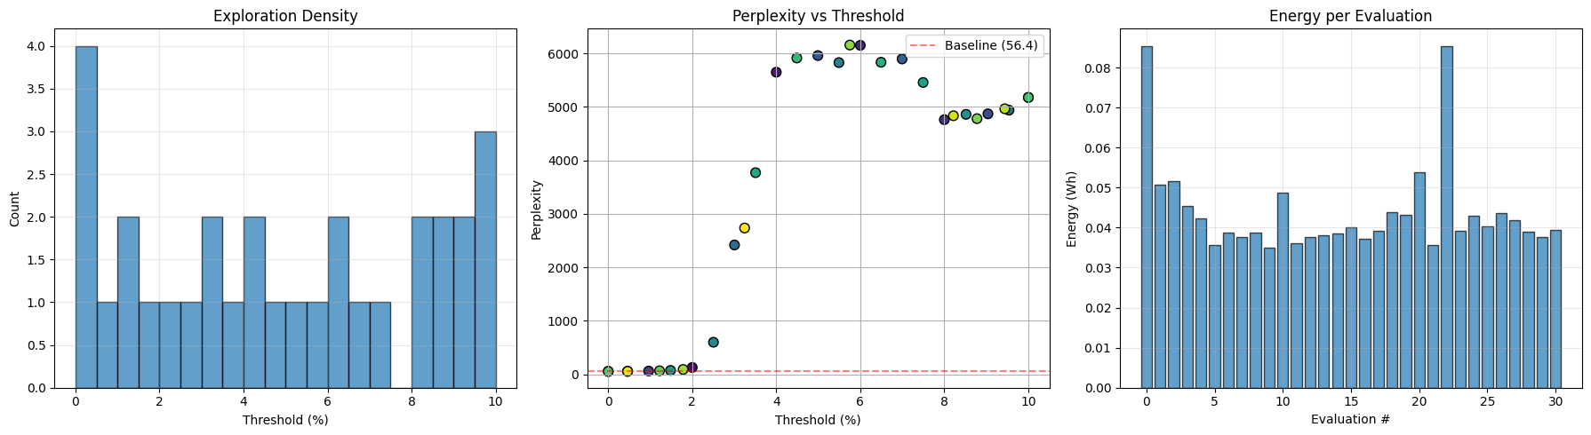
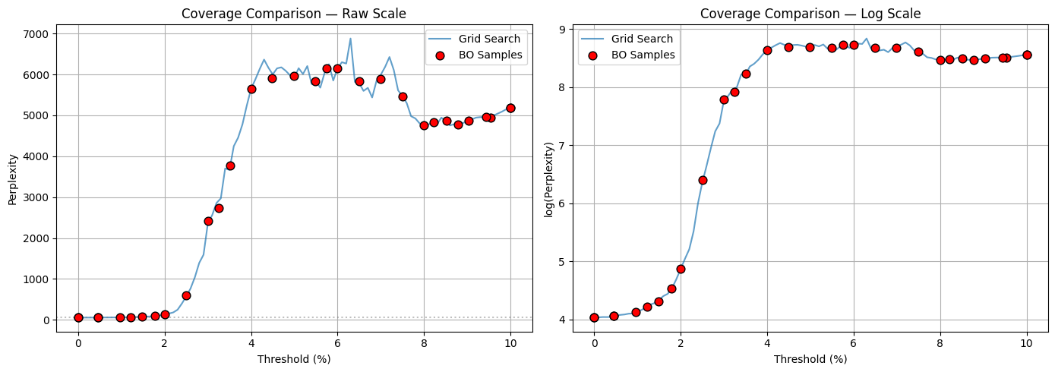

Slide 12
Step 2: Surrogate model creation
Train a Gaussian process surrogate using the threshold evaluations for the 3 models
Select a new unseen model
Use 2-3 real evaluations (e.g. thresholds 0,5,10)
Predict the full curve 0 -> 10 with steps of 0.1
Apply Pareto front analysis (Suggest and optimal threshold)

Slide 13
Next steps
Investigate gaussian surrogate setup
What kernel?
Other hyper params
Separate GP’s per metric / single weighted objective with a scalar
Evaluation
Select unseen models to get predictions for and compare against actual
User testing of perceived value of results

Slide 14
Questions
Is it an issue to use the full dataset to make the pruning result dataset that will be used to train a surrogate?
Would it be better to have a scalar for the surrogate or a multi objective surrogate?

